Slide 1

ASHRAE Dallas Chapter
1/9/2024

Slide 2
Agenda
Why Do We Balance?
Balancing Options
  Reverse Return
  Balancing Valves
    Manual vs. Automatic (Different Technologies)
System Costs
  Initial vs. Long-term
    Material Costs & T&B (Initial)
    System Efficiencies (Long-term)
Auto-Balancing & Modulation

Slide 3
Why Balance?
Reduced water flow reduces heat transfer
Terminals furthest from the pump in unbalanced systems receive less flow resulting in reduced heat transfer
Excessive flow
  Increases pressure drop and pump energy
  Increases pump wear and noise
  Increasing water flow to 200% of coil design
    only increases heat transfer by 6% but, increases pressure drop by 400%

Slide 4
Balancing Options
Reverse Return Piping
Manual Balancing
Automatic Flow Control Valves
Unconventional Methods
Circulating Pumps at Each Unit

Slide 5
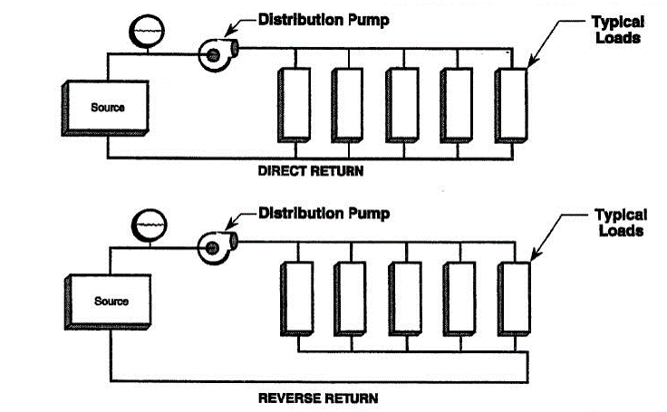
Reverse Return

Slide 6
What Is A Balancing Valve?
Balancing Valves
  provide proper distribution of water flow to terminal units in the system to ensure maximum comfort with minimal energy consumption.
Improves performance of
  HVAC Systems
  Domestic Water Systems

Slide 7
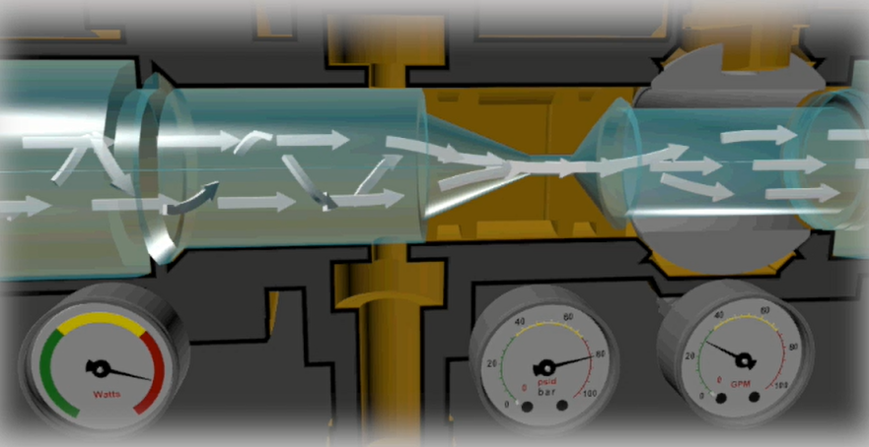
Manual Balancing Valves

Slide 8
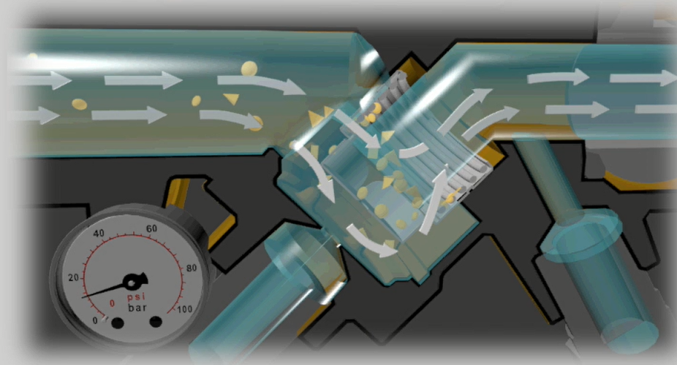
Automatic Flow Control Valves (Spring Type)

Slide 9
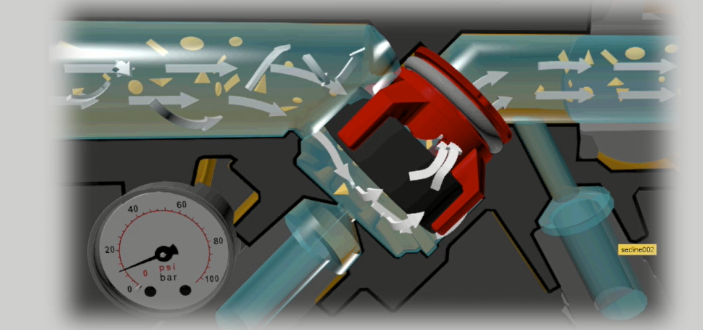
Automatic Flow Control Valves (Diaphragm Orifice)

Slide 10
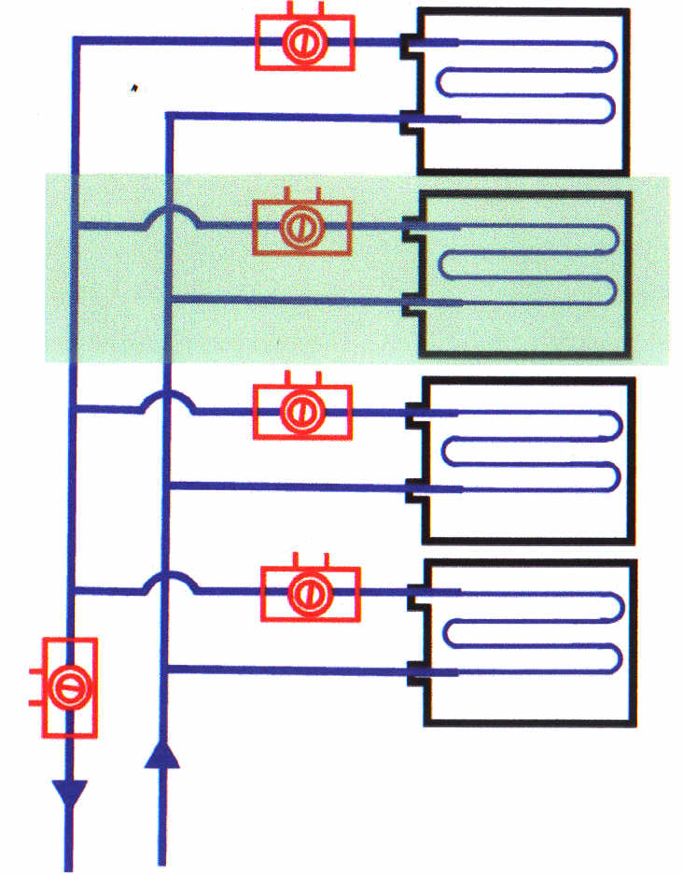
Cost of a System - Manually Balanced
Circuit Balance Valves required at all terminal units
System needs to be rebalanced when new terminal unit(s) added
Manual Balance = No Balancing
  Balanced at 100% Design Flow
  Unbalanced at ALL Other Flows

Slide 11
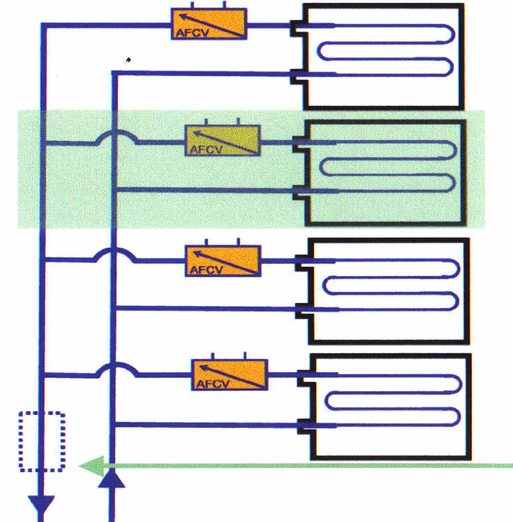
Cost of a System - Automatically Balanced
Automatic Flow Control Valves only required at terminal units
No system rebalancing needed when new terminal unit(s) brought on line.
No AFCV required on riser
AFCV dynamically adjust to maintain flow

Slide 12
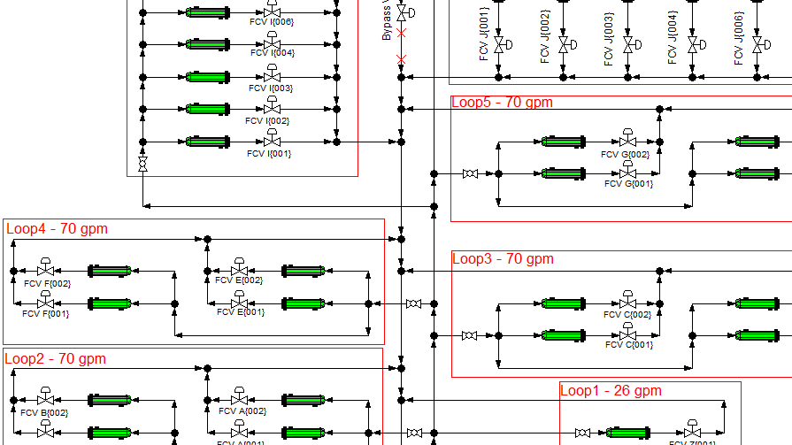
Chilled Water HVAC System Analysis
Notes:
System ‘borrowed’ from an ASHRAE Journal Article

Slide 13
System Configuration
Pumps - 2 Primary & 2 Secondary
Chillers - Inline w/ Primary Pumps
Designed flow rate – 460 gpm (230 gpm per pump)
System analyzed under three different balancing options:
  Fully Open – no balancing
  Manual balancing
  Automatic balancing

Slide 14
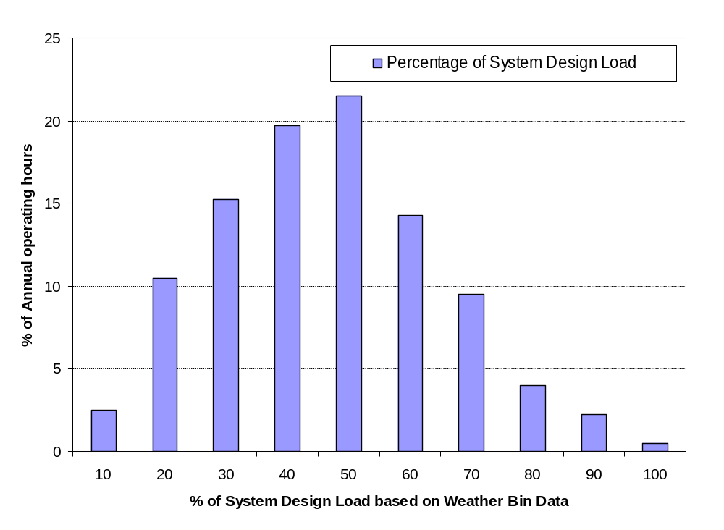
Annual System Load Profile
Normal Operating Conditions:
30- 60% of system design load
System runs less than 2% of the time at full load design conditions
Notes:
This is an average from ASHRAE. A generalization of total system load for 1 year for most application.

Slide 15
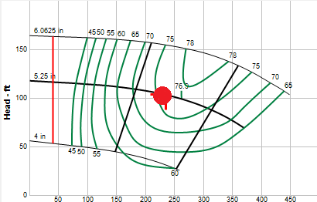
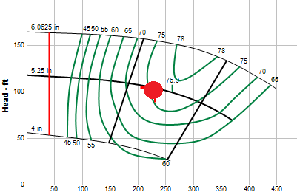
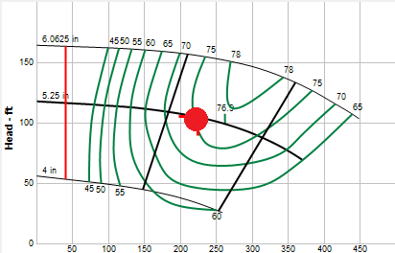
Pump Curves Comparison:
Design Conditions – 100% Load
Pump operating @ 234gpm, 103ft
Pump operating @ 230gpm, 104ft
No Balancing
Manual Balancing
Pump operating @ 224gpm, 105ft
Automatic Balancing
Notes:
Design Conditions means 100% flow. There are two pumps flowing 450 GPM. The graph represents pump curve for Only one of the two pumps for all the balancing options. Both the pumps selected are identical and will behave/perform similar.

Slide 16

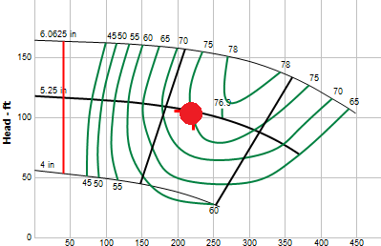
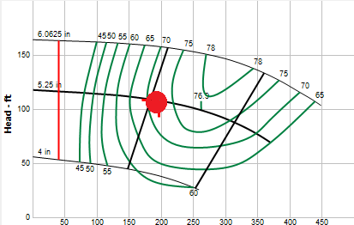
Fixed Speed Pump Curves Comparison:
Design Conditions – 90% Load
Pump operating @ 225gpm
Pump operating @ 222gpm
No Balancing
Manual Balancing
Pump Operating point moving to the left on pump curve = ENERGY SAVINGS
Pump operating @ 197gpm
Automatic Balancing
Notes:
Design Conditions means 100% flow. There are two pumps flowing 450 GPM. The graph represents pump curve for Only one of the two pumps for all the balancing options. Both the pumps selected are identical and will behave/perform similar.

Slide 17
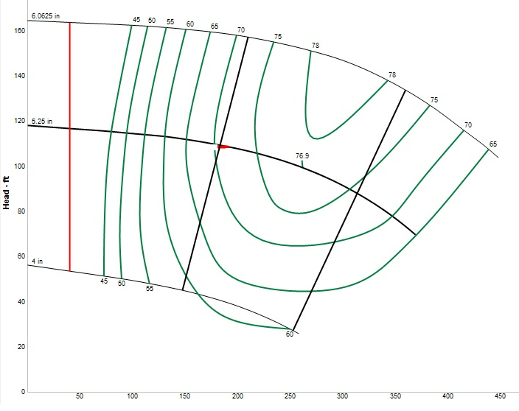
Fixed Speed Pump Curves Comparison:
Design Conditions – 50% Load
Automatic
113 GPM
No Balancing
191 GPM
Manual
182 GPM
Notes:
Design Conditions means 100% flow. There are two pumps flowing 450 GPM. The graph represents pump curve for Only one of the two pumps for all the balancing options. Both the pumps selected are identical and will behave/perform similar.

Slide 18
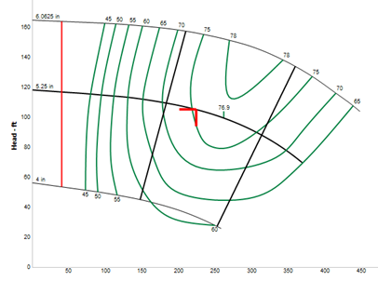
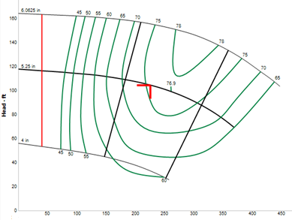
100% Design Flow Condition
(Manual Balancing)
Fixed Speed Drive
Variable Speed Drive
230 gpm
230 gpm
3,500 rpm
Eff: 75.5 %
Power: 8 hp
3,500 rpm
Eff: 75.5 %
Power: 8 hp

Slide 19
100% Design Flow Condition
(Automatic Balancing)
Fixed Speed Drive
Variable Speed Drive
225 gpm
226 gpm
3,500 rpm
Eff: 75.5 %
Power: 8 hp
3,500 rpm
Eff: 75.5 %
Power: 8 hp

Slide 20
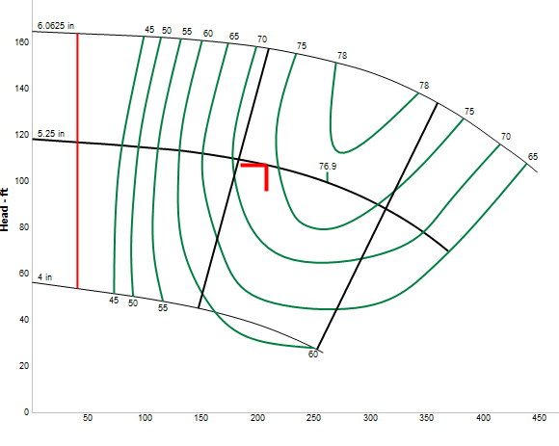
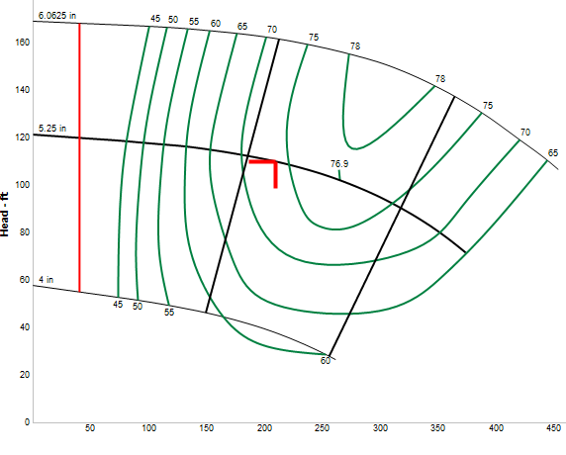
70 % Design Flow Condition
(Manual Balancing)
Fixed Speed Drive
Variable Speed Drive
208 gpm
210 gpm
3,500 rpm
Eff: 73.8 %
Power: 7.6 hp
3,545 rpm
Eff: 73.7 %
Power: 7.9 hp

Slide 21
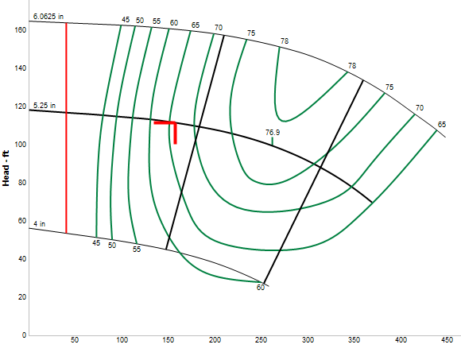
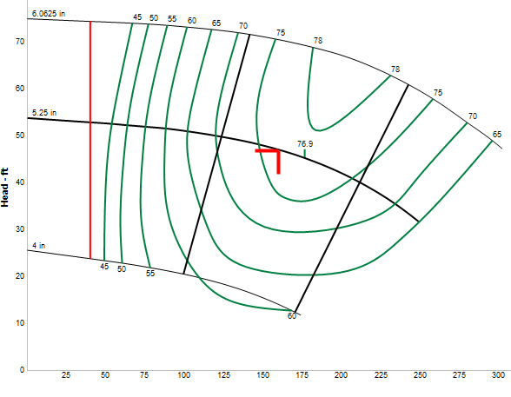
70 % Design Flow Condition
(Automatic Balancing)
Fixed Speed Drive
Variable Speed Drive
158 gpm
160 gpm
3,500 rpm
Eff: 66.3 %
Power: 6.7 hp
2,360 rpm
Eff: 75.8 %
Power: 2.5 hp

Slide 22
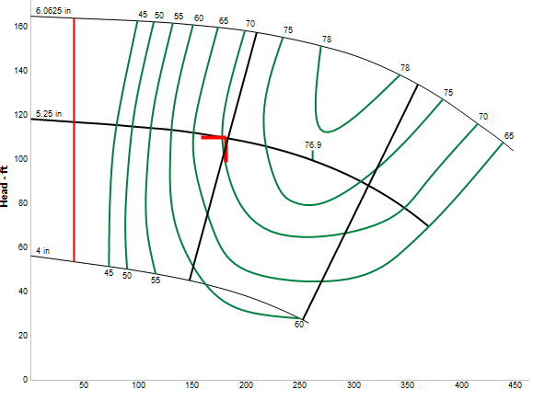
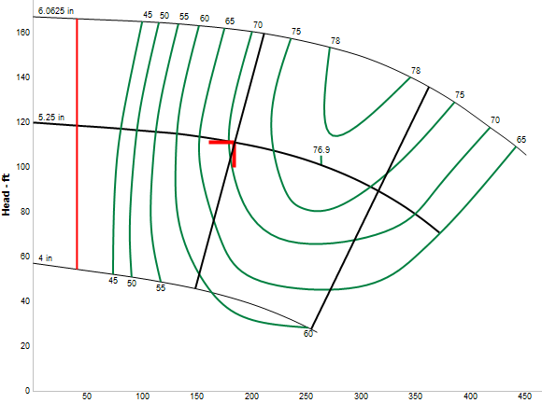
50 % Design Flow Condition
(Manual Balancing)
Fixed Speed Drive
Variable Speed Drive
182 gpm
184 gpm
3,500 rpm
Eff: 70.5 %
Power: 7.1 hp
3,525 rpm
Eff: 70.6 %
Power: 7.3 hp

Slide 23
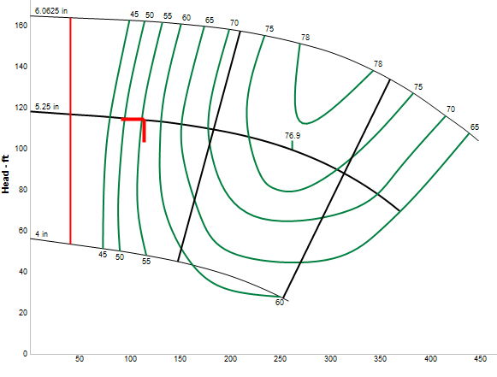
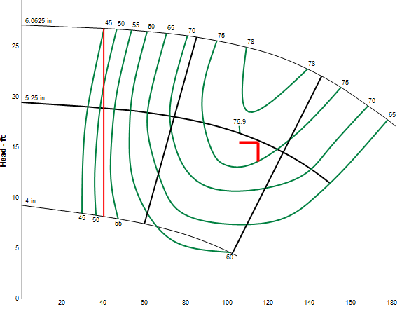
50 % Design Flow Condition
(Automatic Balancing)
Fixed Speed Drive
Variable Speed Drive
113 gpm
115 gpm
3,500 rpm
Eff: 55.6 %
Power: 5.9 hp
1,420 rpm
Eff: 76 %
Power: 0.6 hp

Slide 24
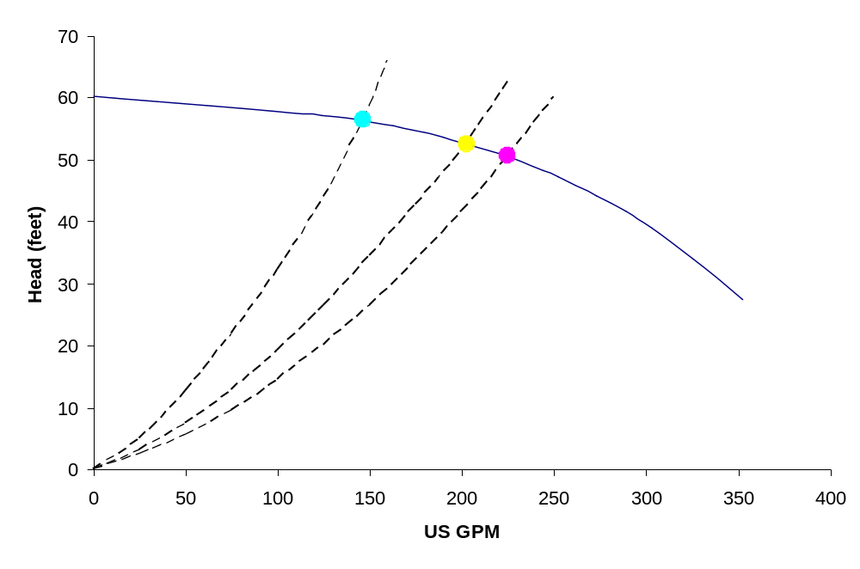
Fixed Speed Pump Operation
70% @ 3.8 hp
30% @ 3.2 hp
100% @ 4 hp
Pump Curve
3500 rpm
Automatic Balancing Valves

Slide 25
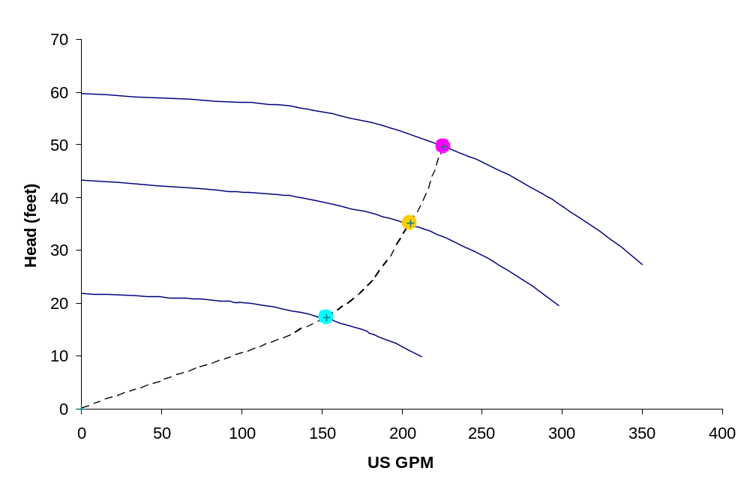
Variable Speed Pump Operation
100% @ 3.9 hp
70% @ 2.5 hp
Pump Curve
3500 rpm
30% @ 0.9 hp
2990 rpm
2130 rpm
Automatic Balancing Valves

Slide 26
Energy Calculations
(2-Position Control Valves @ $0.10 / kwh)
% System Load | % of Operating hours | Operation Cost ($ per % of operating hours)
 |  | Fully Open No balancing | Manual Balancing |  | Automatic Balancing
 |  |  | Fixed Speed Pumping | Variable Speed Pumping | Fixed Speed Pumping | Variable Speed Pumping
30 | 15.25 | 2026 | 1961 | 2031 | 1088 | 1084
40 | 19.75 | 2834 | 2744 | 2828 | 1961 | 1810
50 | 21.5 | 3251 | 3169 | 3275 | 2618 | 2186
60 | 14.25 | 2228 | 2185 | 2238 | 1841 | 1777
70 | 9.50 | 1521 | 1497 | 1545 | 1307 | 997
80 | 4.00 | 652 | 644 | 672 | 586 | 459
90 | 2.25 | 372 | 368 | 370 | 350 | 289
100 | 0.50 | 83 | 83 | 82 | 82 | 82
Approx. Annual Pump Running Cost ($/year) |  | $12,967 | $12,650 | $13,041 | $9836 | $8686

Slide 27
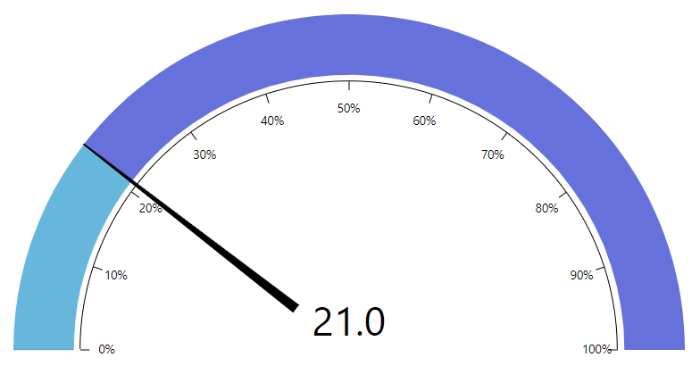
Low psi
Cv rate selection of Control Valve body is critical
Uniform Cv rates lead to poor rangeability and performance
Automatic Balancing Valves kick in to protect the unit from overflow
High psi

Slide 28
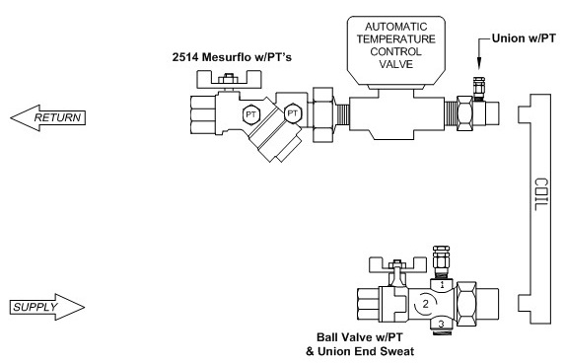
Automatic Balancing Valves & Modulation
FLOW
P3
P2
P1

Slide 29
Automatic Balancing Valves & Modulation
(Control Valve = 100% Open)
Design 3 GPM
3.1 GPM
P2
P1
P3
9.2 PSI
2.5 PSI
4.7 PSI
2.2 PSID

Slide 30
Automatic Balancing Valves & Modulation
(Control Valve = 70% Open)
Design 3 GPM
2.2 GPM
P2
P1
P3
15.2 PSI
2.5 PSI
3.2 PSI
0.7 PSID

Slide 31
Automatic Balancing Valves & Modulation
(Control Valve = 20% Open)
Design 3 GPM
0.5 GPM
P2
P1
P3
22.0 PSI
2.5 PSI
2.5 PSI
0.0 PSID

Slide 32
Conclusion
Manual balancing valves are costly to install/balance & are ineffective during the system’s lifespan
Automatic balancing valves greatly reduce T&B time/cost, eliminate overflow by reacting to system pressure fluctuations, thereby saving energy & improving comfort

Slide 33

QUESTIONS ?

