Slide 1



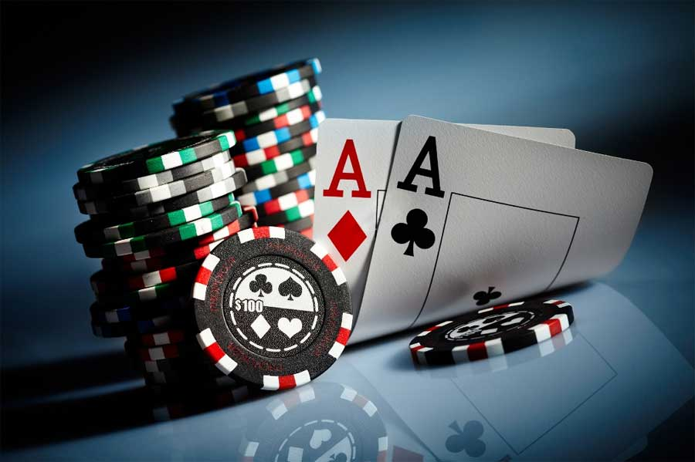
ASHRAE Dallas Chapter
Poker Tournament Fundraiser
Sponsored By
Available Sponsorships:
Food Sponsor - $1,200
Happy Hour Sponsor- $750
Table Rental for Product Demo (8 available) - $500
Table Sponsors (8 available) - $250
Thursday, February 16th
6:00 PM – 9:00 PM
(Registration Starts at 5:30 PM)
(Happy Hour 4:30 – 5:30 PM)
Hosted at HTS Dallas Office
1625 Wallace Drive, Suite 120, Carrollton, TX 75006
Buy-in: $50/Player (re-buy $30)
Includes: Up to 2 ½ Hours of Texas Hold’em; Unlimited Soft Drinks, Tea and Water; Snack Buffet for 2 Hours
Help Raise Money for Research Promotion While Having Endless Fun!
To buy your tickets go to www.dallas-ashrae.org. For questions,
contact Brandon Damas at brandon.damas@hts.com.

